Slide 1
Dynamic Programming

Slide 2
Dynamic Programming
Dynamic Programming is an algorithm design technique for optimization problems: often minimizing or maximizing.
Like divide and conquer, DP solves problems by combining solutions to subproblems.
Unlike divide and conquer, subproblems are not independent.
  Subproblems may share subsubproblems,
  However, solution to one subproblem may not affect the solutions to other subproblems of the same problem. (More on this later.)
DP reduces computation by
  Solving subproblems in a bottom-up fashion.
  Storing solution to a subproblem the first time it is solved.
  Looking up the solution when subproblem is encountered again.
Key: determine structure of optimal solutions

Slide 3
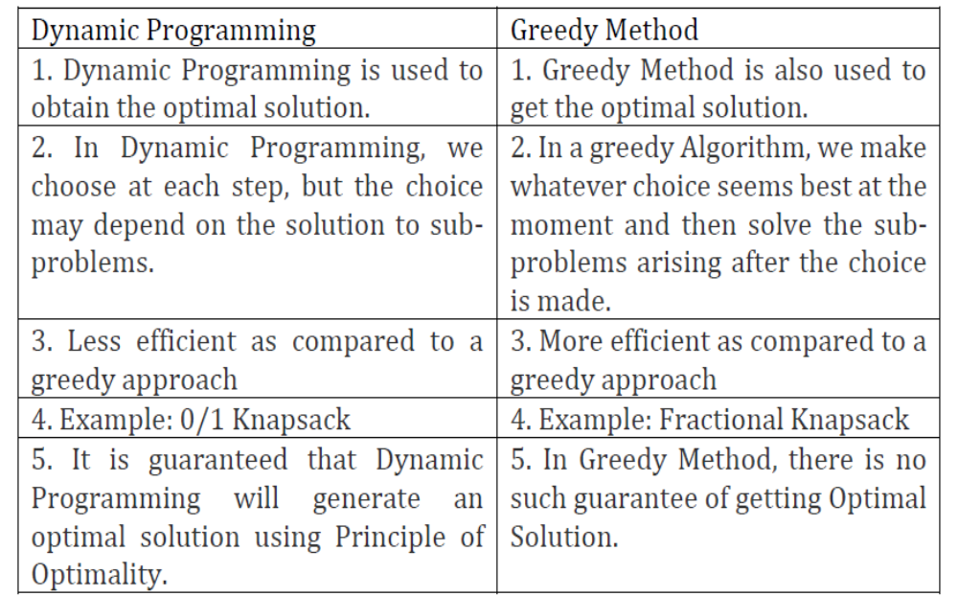

Differences
dynamic

Slide 4
Elements of Dynamic Programming
Optimal substructure
Overlapping subproblems

Slide 5
Optimal Substructure
Show that a solution to a problem consists of making a choice, which leaves one or more subproblems to solve.
Suppose that you are given this last choice that leads to an optimal solution.
Given this choice, determine which subproblems arise and how to characterize the resulting space of subproblems.
Show that the solutions to the subproblems used within the optimal solution must themselves be optimal. Usually use cut-and-paste.
Need to ensure that a wide enough range of choices and subproblems are considered.

Slide 6
Optimal Substructure
Optimal substructure varies across problem domains:
  1. How many subproblems are used in an optimal solution.
  2. How many choices in determining which subproblem(s) to use.
Informally, running time depends on (# of subproblems overall) × (# of choices).
How many subproblems and choices do the examples considered contain?
Dynamic programming uses optimal substructure bottom up.
  First find optimal solutions to subproblems.
  Then choose which to use in optimal solution to the problem.

Slide 7
Optimal Substucture
Does optimal substructure apply to all optimization problems? No.
Applies to determining the shortest path but NOT the longest simple path of an unweighted directed graph.
Why?
  Shortest path has independent subproblems.
  Solution to one subproblem does not affect solution to another subproblem of the same problem.
  Subproblems are not independent in longest simple path.
    Solution to one subproblem affects the solutions to other subproblems.
  Example:

Slide 8
Overlapping Subproblems
The space of subproblems must be “small”.
The total number of distinct subproblems is a polynomial in the input size.
  A recursive algorithm is exponential because it solves the same problems repeatedly.
  If divide-and-conquer is applicable, then each problem solved will be brand new.

Slide 9
Steps in Dynamic Programming
Characterize structure of an optimal solution.
Define value of optimal solution recursively.
Compute optimal solution values either top-down with caching or bottom-up in a table.
Construct an optimal solution from computed values.
We’ll study these with the help of examples.

Slide 10
Binomial Coefficient using Dynamic Programming
Computing binomial coefficient is very fundamental problem of mathematics and computer science.
C(n, k) also defines the number of ways to select any k items out of n items. Mathematically it is defined as,

Slide 11


Many sub problems are called again and again, since they have an overlapping sub problems property.
Re-computations of the same sub problems is avoided by storing their results in the temporary array C[i, j] in a bottom up manner.
The optimal substructure for using dynamic programming is stated as,

Slide 12

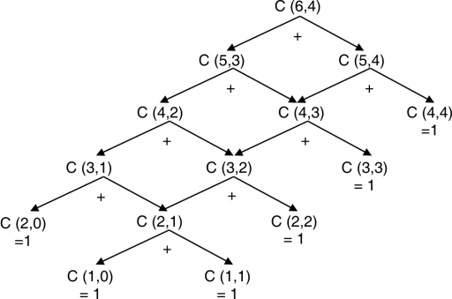

Slide 13
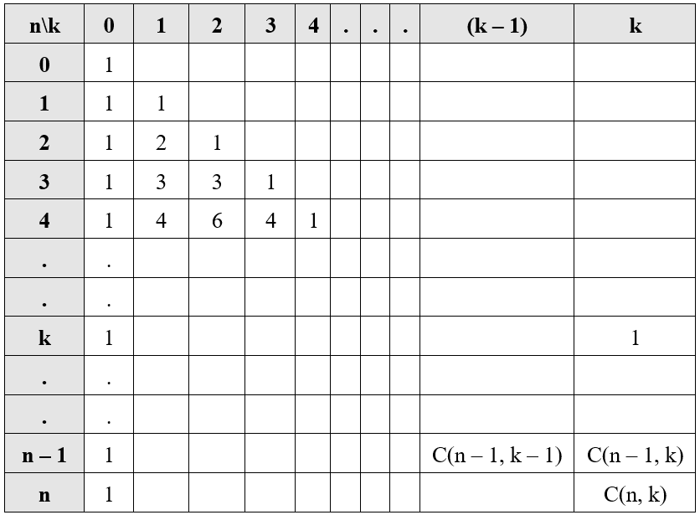

Slide 14
C(5,3)
C(5,3)
C(4,2)
C(4,3)
C(3,1)
C(3,2)
C(3,3)
C(2,0)
C(2,1)
C(2,2)
C(1,0)
C(1,1)
Does this look familiar?
How about if you turn it upside down?
Notes:
Someone may notice that this is exactly how you compute Pascal’s triangle. That’s why I included the thought from Pascal.

Slide 15
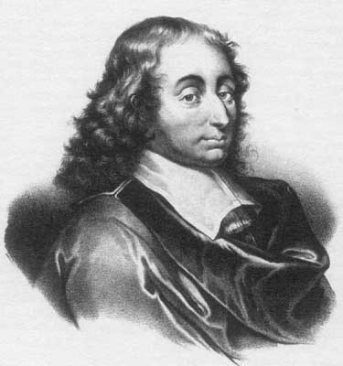
Pascal’s Triangle
Blaise Pascal (1623-1662)
Second person to invent the calculator
Religious philosopher
Mathematician and physicist

Slide 16
From Recurrence to Table
Start with a recurrence relation
Turn it into a table.
  Figure out what the variables are
  Use them to index the rows and columns.
  Figure out what the base case is.
  Do that first in the table
  Then figure out the inductive step and work up to the final answer.

Slide 17
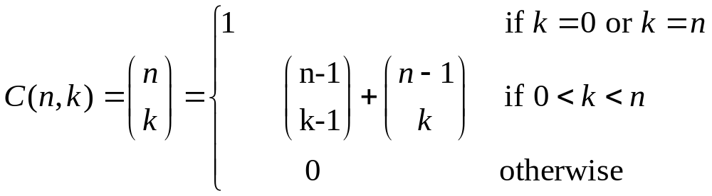

 | 0 | 1 | 2 | 3
0
1
2
3
4
5

Slide 18







 | 0 | 1 | 2 | 3
0
1
2
3
4
5

Slide 19






 | 0 | 1 | 2 | 3
0 | 1
1 | 1 | 1
2 | 1 | 2 | 1
3 | 1 | 3 | 3 | 1
4 | 1 | 4 | 6 | 4
5 | 1 | 5 | 10 | 10

Slide 20
EXERCISE
CALCULATE c(6,4)

Slide 21
Algorithm
function c(n,k)
  If k=0 or k=n then return 1
  else return c(n-1,k-1)+c(n-1,k)
  Complexity Θ(nk)

Slide 22
Making Change using DP
Given j, what’s the fewest coins required to make j in change?
Example:
  m = 4 different denominations of coins.
  Values d = [1 2 4 7]
Compute how many coins needed to make change for value j: coins(d,j)
Does greedy work with d?
Goal: Write Dynamic Programming algorithm.
  Hint: do something like what we did for binomial coefficient.

Slide 23
DP Coins
Given n types of coins (unlimited supplies)
Make c in change.
What’s min. # of coins required?
Formulated as a DP problem.

Slide 24
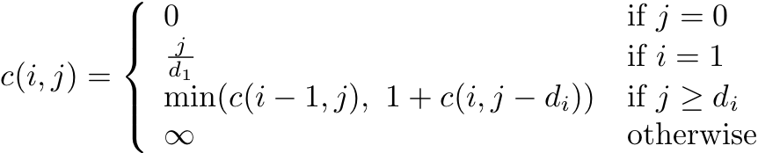
DP Coins
Given n types of coins (unlimited supplies)
Make j in change.
What’s min. # of coins required?
Formulated as a DP problem.
i is the number of coin types remaining.

Slide 25
Recursive Function
Given j, what’s the fewest coins required to make j in change?
Recursive function:
  c[i,j] = number of coins needed to make j cents of change using coins of type 1 through i.
Derive algorithm from recursive function
Modify resulting algorithm for space and time.

Slide 26
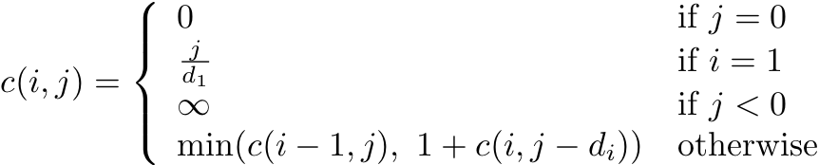
Making Change
Given j, what’s the fewest “coins” required to make j in change?
j
Amount | 0 | 1 | 2 | 3 | 4 | 5 | 6 | 7
senum=1 | 0 | 1 | 2 | 3 | 4 | 5 | 6 | 7
seon=2
shum=4
limnah=7
i
c[i,j] = min. number of “coins” to make j change with coins 1..i.

Slide 27
Making Change
j
Amount | 0 | 1 | 2 | 3 | 4 | 5 | 6 | 7
senine=1 | 0 | 1 | 2 | 3 | 4 | 5 | 6 | 7
seon=2
shum=4
limnah=7
i
c[i,j] = min. number of coins to make j change with coins 1..i.

Slide 28
Making Change
j
Amount | 0 | 1 | 2 | 3 | 4 | 5 | 6 | 7
senine=1 | 0 | 1 | 2 | 3 | 4 | 5 | 6 | 7
seon=2 | 0 | 1 | ???
shum=4
limnah=7
i
How does one compute c[2,2]?

Slide 29


Making Change
j
Amount | 0 | 1 | 2 | 3 | 4 | 5 | 6 | 7
senine=1 | 0 | 1 | 2 | 3 | 4 | 5 | 6 | 7
seon=2 | 0 | 1 | 1
shum=4
limnah=7
i
+1
How does one compute c[2,2]?

Slide 30
Making Change
j
Amount | 0 | 1 | 2 | 3 | 4 | 5 | 6 | 7
senine=1 | 0 | 1 | 2 | 3 | 4 | 5 | 6 | 7
seon=2 | 0 | 1 | 1 | 2
shum=4
limnah=7
i
+1
How does one compute c[2,2]?

Slide 31
Making Change
j
Amount | 0 | 1 | 2 | 3 | 4 | 5 | 6 | 7
senine=1 | 0 | 1 | 2 | 3 | 4 | 5 | 6 | 7
seon=2 | 0 | 1 | 1 | 2 | 2
shum=4
limnah=7
i
+1

Slide 32
Making Change
j
Amount | 0 | 1 | 2 | 3 | 4 | 5 | 6 | 7
senine=1 | 0 | 1 | 2 | 3 | 4 | 5 | 6 | 7
seon=2 | 0 | 1 | 1 | 2 | 2 | 3
shum=4
limnah=7
i
+1

Slide 33

Making Change
j
Amount | 0 | 1 | 2 | 3 | 4 | 5 | 6 | 7
senine=1 | 0 | 1 | 2 | 3 | 4 | 5 | 6 | 7
seon=2 | 0 | 1 | 1 | 2 | 2 | 3
shum=4
limnah=7
i
+1

Slide 34
Making Change
j
Amount | 0 | 1 | 2 | 3 | 4 | 5 | 6 | 7
senine=1 | 0 | 1 | 2 | 3 | 4 | 5 | 6 | 7
seon=2 | 0 | 1 | 1 | 2 | 2 | 3 | 3 | 4
shum=4 | 0 | 1 | 1 | 2 | 1 | 2 | 2 | 3
limnah=7 | 0 | 1 | 1 | 2 | 1 | 2 | 2 | 1
i

Slide 35
Extracting a Solution
j
Amount | 0 | 1 | 2 | 3 | 4 | 5 | 6 | 7
senine=1 | 0 | 1 | 2 | 3 | 4 | 5 | 6 | 7
seon=2 | 0 | 1 | 1 | 2 | 2 | 3 | 3 | 4
shum=4 | 0 | 1 | 1 | 2 | 1 | 2 | 2 | 3
limnah=7 | 0 | 1 | 1 | 2 | 1 | 2 | 2 | 1
i
c[4,7]=c[4,7-7]+1,
so include a limnah
Move to c[4,7-7].

Slide 36
Extracting a Solution
j
Amount | 0 | 1 | 2 | 3 | 4 | 5 | 6 | 7
senine=1 | 0 | 1 | 2 | 3 | 4 | 5 | 6 | 7
seon=2 | 0 | 1 | 1 | 2 | 2 | 3 | 3 | 4
shum=4 | 0 | 1 | 2 | 3 | 1 | 2 | 2 | 3
limnah=7 | 0 | 1 | 2 | 3 | 1 | 2 | 2 | 1
i
c[4,0] = c[4-1,0]
Do nothing.
Move up.
c[4,7]=c[4,7-7]+1,
so include a limnah
Move to c[4,7-7].

Slide 37
Extracting a Solution
j
Amount | 0 | 1 | 2 | 3 | 4 | 5 | 6 | 7
senine=1 | 0 | 1 | 2 | 3 | 4 | 5 | 6 | 7
seon=2 | 0 | 1 | 1 | 2 | 2 | 3 | 3 | 4
shum=4 | 0 | 1 | 2 | 3 | 1 | 2 | 2 | 3
limnah=7 | 0 | 1 | 2 | 3 | 1 | 2 | 2 | 1
i
c[4,0] = c[4-1,0]
Do nothing.
Move up.
c[4,7]=c[4,7-7]+1,
so include a limnah
Move to c[4,7-7].

Slide 38
Extracting a Solution
j
Amount | 0 | 1 | 2 | 3 | 4 | 5 | 6 | 7
senine=1 | 0 | 1 | 2 | 3 | 4 | 5 | 6 | 7
seon=2 | 0 | 1 | 1 | 2 | 2 | 3 | 3 | 4
shum=4 | 0 | 1 | 2 | 2 | 1 | 2 | 2 | 3
limnah=7 | 0 | 1 | 2 | 2 | 1 | 2 | 2 | 1
i
not=
c[3,7-4] = c[3,7]-1
give a shum
move left.

Slide 39



Extracting a Solution
j
Amount | 0 | 1 | 2 | 3 | 4 | 5 | 6 | 7
senine=1 | 0 | 1 | 2 | 3 | 4 | 5 | 6 | 7
seon=2 | 0 | 1 | 1 | 2 | 2 | 3 | 3 | 4
shum=4 | 0 | 1 | 2 | 2 | 1 | 2 | 2 | 3
limnah=7 | 0 | 1 | 2 | 2 | 1 | 2 | 2 | 1
i
not=
c[3,7-4] = c[3,7]-1
give a shum
move left.

Slide 40
Extracting a Solution
j
Amount | 0 | 1 | 2 | 3 | 4 | 5 | 6 | 7
senine=1 | 0 | 1 | 2 | 3 | 4 | 5 | 6 | 7
seon=2 | 0 | 1 | 1 | 2 | 2 | 3 | 3 | 4
shum=4 | 0 | 1 | 2 | 2 | 1 | 2 | 2 | 3
limnah=7 | 0 | 1 | 2 | 2 | 1 | 2 | 2 | 1
i
How much space?
How much time?

Slide 41
Algorithm in Pseudo-code
function coins(d, N)
Input: Array d[1..n] specifies the coinage;
N is the number of units for which to make change
Output: Minimum number of coins needed to make change for N units using coins from d
array c[1..n,0..N]
for i=1 to n do
c[i,0] = 0
for i=1 to n do
for j=1 to N do
if i=1 and j<d[i] then
c[i,j] = +infinity
else if i=1 then
c[i,j] = 1+c[1,j-d[1]]
else if j<d[i] then
c[i,j] = c[i-1,j]
else
c[i,j] = min(c[i-1,j],1+c[i,j-d[i]])
return c[n,N]

Slide 42
Pre-computing vs. on-the-fly
Like lazy vs. eager evaluation
Pre-computing
  build table, then analyze results.
On-the-fly
  build table entries as you go

Slide 43
Making Change: Top Down
j
Amount | 0 | 1 | 2 | 3 | 4 | 5 | 6 | 7
senine=1
seon=2
shum=4
limnah=7
i
Top down: start at bottom right, make recursive calls.

Slide 44
Making Change
j
Amount | 0 | 1 | 2 | 3 | 4 | 5 | 6 | 7
senine=1
seon=2
shum=4
limnah=7
i
Top down: start at bottom right, make recursive calls.
Save time by storing every intermediate value.

Slide 45

Making Change
j
Amount | 0 | 1 | 2 | 3 | 4 | 5 | 6 | 7
senine=1
seon=2
shum=4
limnah=7
i
How much space and time did this require?

Slide 46
Comparison
How does DP algorithm compare to greedy?
  speed
  space
  correctness
  simplicity

Slide 47
Longest Common Subsequence
Problem: Given 2 sequences, X = ⟨x₁,...,x_{m}⟩ and
Y = ⟨y₁,...,y_{n}⟩, find a common subsequence whose length is maximum.
springtime ncaa tournament basketball
printing north carolina krzyzewski
Subsequence need not be consecutive, but must be in order.

Slide 48
Longest Common Subsequence
Problem: Given 2 sequences, X = ⟨x₁,...,x_{m}⟩ and
Y = ⟨y₁,...,y_{n}⟩, find a common subsequence whose length is maximum.
springtime ncaa tournament basketball
printing north carolina snoeyink
Subsequence need not be consecutive, but must be in order.

Slide 49
Other sequence questions
Edit distance: Given 2 sequences, X = ⟨x₁,...,x_{m}⟩ and Y = ⟨y₁,...,y_{n}⟩, what is the minimum number of deletions, insertions, and changes that you must do to change one to another?
Protein sequence alignment: Given a score matrix on amino acid pairs, s(a,b) for a,b∈{Λ} ∪A,
and 2 amino acid sequences, X = ⟨x₁,...,x_{m}⟩∈A^{m} and Y = ⟨y₁,...,y_{n}⟩∈A^{n}, find the alignment with lowest score…

Slide 50
More problems
Optimal BST: Given sequence K = k₁ < k₂ <··· < k_{n} of n sorted keys, with a search probability p_{i} for each key k_{i}, build a binary search tree (BST) with minimum expected search cost.
Matrix chain multiplication: Given a sequence of matrices A₁ A₂ … A_{n}, with A_{i} of dimension m_{i}×n_{i}, insert parenthesis to minimize the total number of scalar multiplications.
Minimum convex decomposition of a polygon,
Hydrogen placement in protein structures, …

Slide 51
Naïve Algorithm
For every subsequence of X, check whether it’s a subsequence of Y .
Time: Θ(n2^{m}).
  2^{m} subsequences of X to check.
  Each subsequence takes Θ(n) time to check:
  scan Y for first letter, for second, and so on.

Slide 52
Optimal Substructure
Theorem
Let Z = ⟨z₁, . . . , z_{k}⟩ be any LCS of X and Y .
1. If x_{m} = y_{n}, then z_{k} = x_{m} = y_{n} and Z_{k-1} is an LCS of X_{m-1} and Y_{n-1}.
2. If x_{m} ≠ y_{n}, then either z_{k} ≠ x_{m} and Z is an LCS of X_{m-1} and Y .
3. or z_{k} ≠ y_{n} and Z is an LCS of X and Y_{n-1}.
Notation:
prefix X_{i} = ⟨x₁,...,x_{i}⟩ is the first i letters of X.
This says what any longest common subsequence must look like;
do you believe it?

Slide 53
Optimal Substructure
Theorem
Let Z = ⟨z₁, . . . , z_{k}⟩ be any LCS of X and Y .
1. If x_{m} = y_{n}, then z_{k} = x_{m} = y_{n} and Z_{k-1} is an LCS of X_{m-1} and Y_{n-1}.
2. If x_{m} ≠ y_{n}, then either z_{k} ≠ x_{m} and Z is an LCS of X_{m-1} and Y .
3. or z_{k} ≠ y_{n} and Z is an LCS of X and Y_{n-1}.
Proof: (case 1: x_{m} = y_{n})
Any sequence Z’ that does not end in x_{m} = y_{n} can be made longer by adding x_{m} = y_{n} to the end. Therefore,
longest common subsequence (LCS) Z must end in x_{m} = y_{n}.
Z_{k-1} is a common subsequence of X_{m-1} and Y_{n-1}, and
there is no longer CS of X_{m-1} and Y_{n-1}, or Z would not be an LCS.

Slide 54
Optimal Substructure
Theorem
Let Z = ⟨z₁, . . . , z_{k}⟩ be any LCS of X and Y .
1. If x_{m} = y_{n}, then z_{k} = x_{m} = y_{n} and Z_{k-1} is an LCS of X_{m-1} and Y_{n-1}.
2. If x_{m} ≠ y_{n}, then either z_{k} ≠ x_{m} and Z is an LCS of X_{m-1} and Y .
3. or z_{k} ≠ y_{n} and Z is an LCS of X and Y_{n-1}.
Proof: (case 2: x_{m} ≠ y_{n}, and z_{k} ≠ x_{m})
Since Z does not end in x_{m},
Z is a common subsequence of X_{m-1} and Y, and
there is no longer CS of X_{m-1} and Y, or Z would not be an LCS.

Slide 55
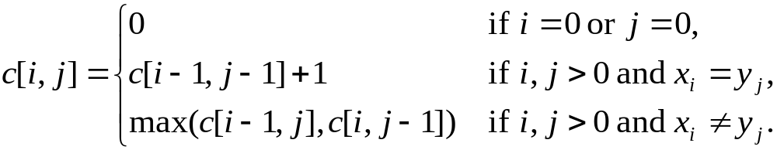
Recursive Solution
Define c[i, j] = length of LCS of X_{i} and Y_{j} .
We want c[m,n].
This gives a recursive algorithm and solves the problem.
But does it solve it well?

Slide 56
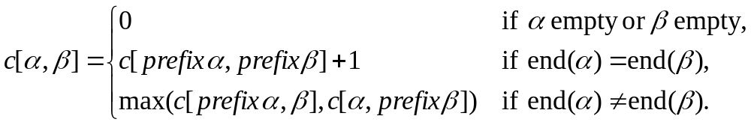
Recursive Solution
c[springtime, printing]
c[springtim, printing] c[springtime, printin]
[springti, printing] [springtim, printin] [springtim, printin] [springtime, printi]
[springt, printing] [springti, printin] [springtim, printi] [springtime, print]

Slide 57
Recursive Solution
 |  | p | r | i | n | t | i | n | g
s
p
r
i
n
g
t
i
m
e
Keep track of c[α,β] in a table of nm entries:
  top/down
  bottom/up

Slide 58
Computing the length of an LCS
LCS-LENGTH (X, Y)
m ← length[X]
n ← length[Y]
for i ← 1 to m
do c[i, 0] ← 0
for j ← 0 to n
do c[0, j ] ← 0
for i ← 1 to m
do for j ← 1 to n
do if x_{i} = y_{j}
then c[i, j ] ← c[i−1, j−1] + 1
b[i, j ] ← “ ”
else if c[i−1, j ] ≥ c[i, j−1]
then c[i, j ] ← c[i− 1, j ]
b[i, j ] ← “↑”
else c[i, j ] ← c[i, j−1]
b[i, j ] ← “←”
return c and b
b[i, j ] points to table entry whose subproblem we used in solving LCS of X_{i}
and Y_{j}.
c[m,n] contains the length of an LCS of X and Y.
Time: O(mn)

Slide 59
Constructing an LCS
PRINT-LCS (b, X, i, j)
if i = 0 or j = 0
then return
if b[i, j ] = “ ”
then PRINT-LCS(b, X, i−1, j−1)
print x_{i}
elseif b[i, j ] = “↑”
then PRINT-LCS(b, X, i−1, j)
else PRINT-LCS(b, X, i, j−1)
Initial call is PRINT-LCS (b, X,m, n).
When b[i, j ] = , we have extended LCS by one character. So LCS = entries with in them.
Time: O(m+n)

Slide 60
Steps in Dynamic Programming
Characterize structure of an optimal solution.
Define value of optimal solution recursively.
Compute optimal solution values either top-down with caching or bottom-up in a table.
Construct an optimal solution from computed values.
We’ll study these with the help of examples.

Slide 61
Optimal Binary Search Trees
Problem
  Given sequence K = k₁ < k₂ <··· < k_{n} of n sorted keys,
  with a search probability p_{i} for each key k_{i}.
  Want to build a binary search tree (BST)
  with minimum expected search cost.
  Actual cost = # of items examined.
  For key k_{i}, cost = depth_{T}(k_{i})+1, where depth_{T}(k_{i}) = depth of k_{i} in BST T .

Slide 62
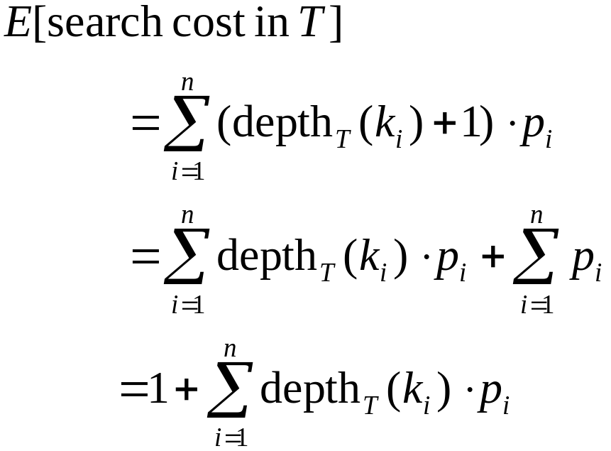
Expected Search Cost
Sum of probabilities is 1.
(15.16)

Slide 63
Example
Consider 5 keys with these search probabilities:
p₁ = 0.25, p₂ = 0.2, p₃ = 0.05, p₄ = 0.2, p₅ = 0.3.
k₂
i depth_{T}(k_{i}) depth_{T}(k_{i})·p_{i}
1 1 0.25
2 0 0
3 2 0.1
4 1 0.2
5 2 0.6
1.15
k₁
k₄
k₃
k₅
Therefore, E[search cost] = 2.15.

Slide 64
Example
p₁ = 0.25, p₂ = 0.2, p₃ = 0.05, p₄ = 0.2, p₅ = 0.3.
k₂
i depth_{T}(k_{i}) depth_{T}(k_{i})·p_{i}
1 1 0.25
2 0 0
3 3 0.15
4 2 0.4
5 1 0.3
1.10
k₁
k₅
k₄
Therefore, E[search cost] = 2.10.
k₃
This tree turns out to be optimal for this set of keys.

Slide 65
Example
Observations:
  Optimal BST may not have smallest height.
  Optimal BST may not have highest-probability key at root.
Build by exhaustive checking?
  Construct each n-node BST.
  For each,
  assign keys and compute expected search cost.
  But there are Ω(4^{n}/n^{3/2}) different BSTs with n nodes.

Slide 66
Optimal Substructure
Any subtree of a BST contains keys in a contiguous range k_{i}, ..., k_{j} for some 1 ≤ i ≤ j ≤ n.
If T is an optimal BST and
T contains subtree T′ with keys k_{i}, ... ,k_{j} ,
then T′ must be an optimal BST for keys k_{i}, ..., k_{j}.
Proof: Cut and paste.
T
T′

Slide 67
Optimal Substructure
One of the keys in k_{i}, …,k_{j}, say k_{r}, where i ≤ r ≤ j,
must be the root of an optimal subtree for these keys.
Left subtree of k_{r} contains k_{i},...,k_{r−1}.
Right subtree of k_{r} contains k_{r}+1, ...,k_{j}.
To find an optimal BST:
  Examine all candidate roots k_{r} , for i ≤ r ≤ j
  Determine all optimal BSTs containing k_{i},...,k_{r−1} and containing k_{r+1},...,k_{j}
k_{r}
k_{i}
k_{r-1}
k_{r+1}
k_{j}

Slide 68
Recursive Solution
Find optimal BST for k_{i},...,k_{j}, where i ≥ 1, j ≤ n, j ≥ i−1. When j = i−1, the tree is empty.
Define e[i, j ] = expected search cost of optimal BST for k_{i},...,k_{j}.
If j = i−1, then e[i, j ] = 0.
If j ≥ i,
  Select a root k_{r}, for some i ≤ r ≤ j .
  Recursively make an optimal BSTs
    for k_{i},..,k_{r−1} as the left subtree, and
    for k_{r+1},..,k_{j} as the right subtree.

Slide 69
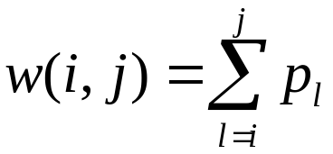
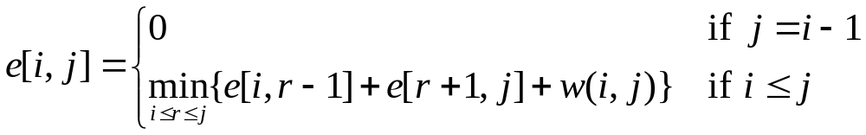
Recursive Solution
When the OPT subtree becomes a subtree of a node:
  Depth of every node in OPT subtree goes up by 1.
  Expected search cost increases by
If k_{r} is the root of an optimal BST for k_{i},..,k_{j} :
  e[i, j ] = p_{r} + (e[i, r−1] + w(i, r−1))+(e[r+1, j] + w(r+1, j))
  = e[i, r−1] + e[r+1, j] + w(i, j).
But, we don’t know k_{r}. Hence,
from (15.16)
(because w(i, j)=w(i,r−1) + p_{r} + w(r + 1, j))

Slide 70
Computing an Optimal Solution
For each subproblem (i,j), store:
expected search cost in a table e[1 ..n+1 , 0 ..n]
  Will use only entries e[i, j ], where j ≥ i−1.
root[i, j ] = root of subtree with keys k_{i},..,k_{j}, for 1 ≤ i ≤ j ≤ n.
w[1..n+1, 0..n] = sum of probabilities
  w[i, i−1] = 0 for 1 ≤ i ≤ n.
  w[i, j ] = w[i, j-1] + p_{j} for 1 ≤ i ≤ j ≤ n.

Slide 71
Pseudo-code
OPTIMAL-BST(p, q, n)
for i ← 1 to n + 1
do e[i, i− 1] ← 0
w[i, i− 1] ← 0
for l ← 1 to n
do for i ← 1 to n−l + 1
do j ←i + l−1
e[i, j ]←∞
w[i, j ] ← w[i, j−1] + p_{j}
for r ←i to j
do t ← e[i, r−1] + e[r + 1, j ] + w[i, j ]
if t < e[i, j ]
then e[i, j ] ← t
root[i, j ] ←r
return e and root
Consider all trees with l keys.
Fix the first key.
Fix the last key
Determine the root
of the optimal
(sub)tree
Time: O(n³)

